Slide 1

TVHC SKILLS TEST
Presented by Hector Sanchez

Slide 2
Introduction & Background
Why Blood Pressure Matters:
High BP is a major risk factor for strokes, heart disease, and kidney failure
It can go unnoticed without routine monitoring
BP Management can improve long term health outcomes
Clinical Interventions play a key role in improving BP control
“Nearly 1 in 2 U.S. adults has high blood pressure” – American Heart Association

Slide 3
OBJECTIVE
Assess the impact of various interventions on BP control
Compare pre- and post- intervention blood pressure metrics
Calculate the percentage of patients achieving BP control (systolic < 140 mmHg and diastolic < 90 mmHg) after intervention
Identify trends in outcomes by demographic characteristics and provider or site

Slide 4
KEY FINDINGS SUMMARY
What I Discovered:
60% of patients achieved controlled BP post-intervention
25% of patients misclassified, Site A accounted for 56% of errors
Intervention Effectiveness:
Clinical Pharmacy Program: 81.8% control
Health Coaching: 76.9%
Medication Adjustment: 75%
Home BP Monitoring and Care Team Outreach below 41%
BP control varied by site (52%-71%)
Demographic Disparities:
Males (63.8%) > Females (54.8%)
Medicare/uninsured(~56%) < Medicaid/commercial (~63%)
BP Control declines with age: 74% (30-44 yrs) -> 48% (60-74 yrs)

Slide 5
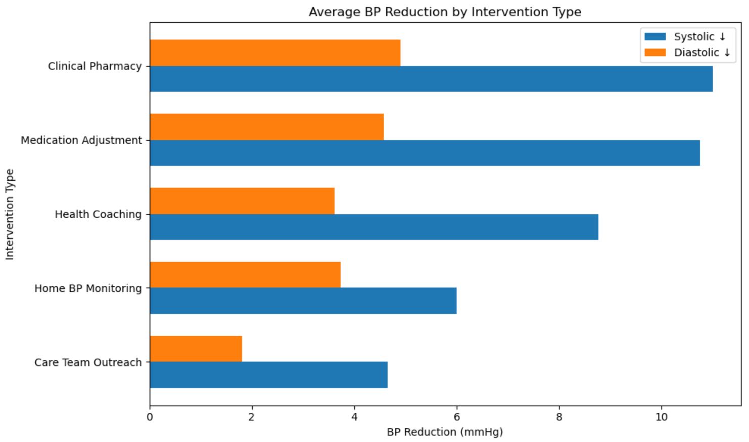
BEFORE & AFTER RESULTS
Blood Pressure Improvements After Intervention
Average Systolic BP dropped by 8.25 mmHg (~6% decrease)
Average Diastolic BP dropped by 3.68 mmHg) (~4% decrease)
Blood Pressure Improvements by Intervention
Notes:
This chart shows the average reduction in blood pressure by intervention type. For each intervention, we've broken down the results into Systolic and Diastolic reductions. The longer the bar, the greater the improvement

Slide 6
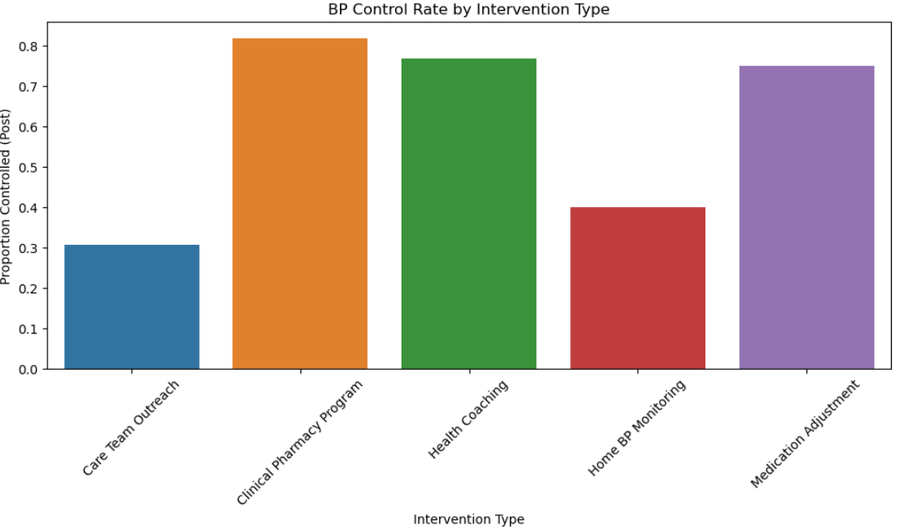
INTERVENTION EFFECTIVENESS
Notes:
This bar chart shows the average blood pressue control rate for each type of intervention. We can immediately see which intervention was the most effective overall in improving BP control across all patients. For example, since 'Clinical Pharmacy Program' has the highest bar, it suggests that patients who received this program were more likely to achieve BP control compared to those who did not.

Slide 7
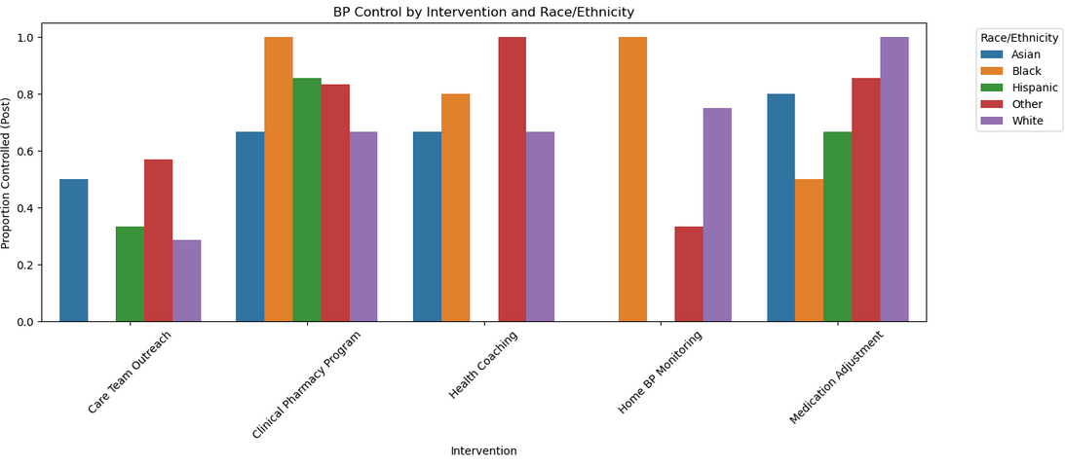
INTERVENTION EFFECTIVENESS
Notes:
Here, we've broken down the intervention outcomes by race and ethnicity. This grouped bar plot helps us identify whether certain interventions were more or less effective depending on the patient's racial or ethnic background. This is important for highlighting disparities in health outcomes and tailoring future interventions to be more inclusive and equitable.

Slide 8
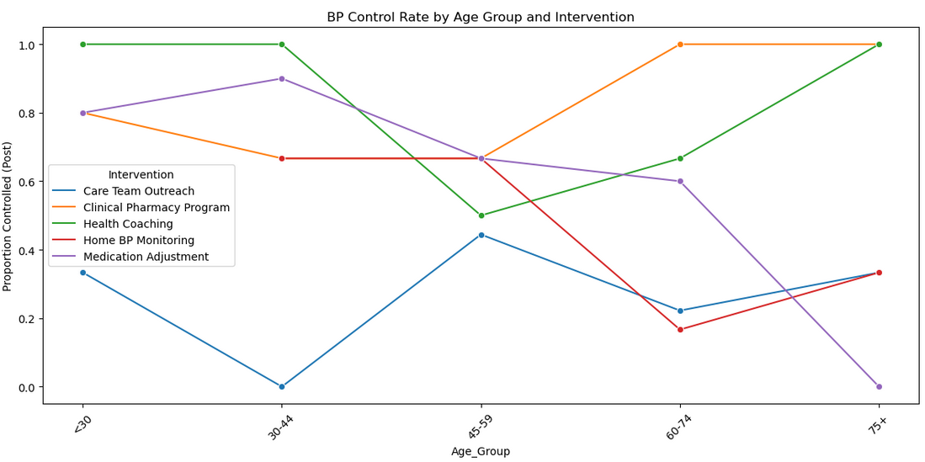
INTERVENTION EFFECTIVENESS
Notes:
This line chart tracks how each intervention performs across different age groups. Each line represents one intervention, and the points show the BP control rate by age category. This helps us understand which interventions work better for younger versus older patients, potentially guiding age targeted strategies.

Slide 9
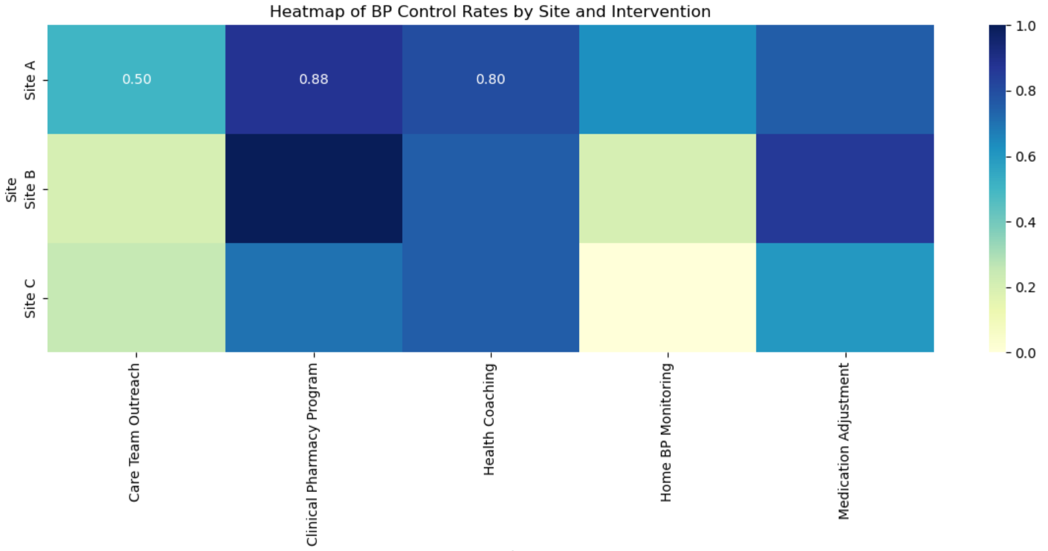
INTERVENTION EFFECTIVENESS
Notes:
This heatmap gives us a high level view of how each site performed under different interventions. Darker colors represent higher BP control rates. This visualization helps us identify which sites are excelling or struggling with specific interventions, and can inform operational or training improvements.

Slide 10
EQUITY & DEMOGRAPHICS
Who Benefits Most?:
Males: Higher BP Control (63.8%)
Clinical Pharmacy Program was effective across ALL race groups
Hispanic (64.3%) and Other(67.9%) race groups had the highest BP control rates
Medicaid patients: Strong outcomes across most interventions (100% in some)
Who Needs More Support?:
Females: Lower BP control (54.8%)
BP Control declined with age: 74% in ages 30-44 and 48% in ages 60-74
Black(50%) and Asian(56.3%) race groups had the lowest BP control rates
Medicare & Uninsured: Lower control (~56%) and less consistent success

Slide 11
RECOMMENDATIONS
1. Improve Data Quality and Accuracy
Why: Large discrepancy between the reported BP_Controlled_Post variable and the actual BP values after intervention.
Action: Standardize the criteria used to classify BP control across all sites to ensure data reliability and consistency.
2. Expand Access to High-Impact Interventions
Why: Certain interventions (Clinical Pharmacy Program) showed significantly better improvements in systolic and diastolic BP.
Action: Apply more effective interventions across all patient groups.
3. Target At-Risk Populations
Why: Some patient subgroups had significantly lower BP control rates
Action: Identify high risk segments (by Sex, Race/Ethnicity, Insurance, Age) and tailor interventions to address their specific barriers.

Slide 12
RECOMMENDATIONS
4. Standardize Best-Practices Across Sites
Why: Some sites performed better in reducing BP or applying effective interventions.
Action: Investigate workflows, staffing, and follow up processes at top performing sites and apply learnings to underperforming sites.
5. Enhance Reporting Metrics
Why: Tracking average changes in BP offers more nuance than binary “controlled/uncontrolled” outcomes and helps highlight meaningful improvements
Action: Integrate mean BP change and percent improvement metrics into clinical dashboards to support data driven decision making.

Slide 13
Q&A/Appendix
View My Full Analysis and Slides on Github:
https://github.com/hesanche94/TVHC/tree/main

Slide 14
THANK
YOU!

